Slide 1



Compressive tracking in mm wave picocells
Upamanyu Madhow
ECE Department
University of California, Santa Barbara

Slide 2







Collaborators
2012-2014
Dinesh Ramasamy
(now at Uber)
Sriram Venkateswaran
(now at Kumu)
2014-present
Zhinus Marzi
Maryam E. Rasekh
Babak Mamandipoor
Prof. Heather Zheng (U. Chicago)
Yanzi Zhu

Slide 3











Network context
base station
base station
32x32
8cmx8cm
Picocell
Picocell
Can fit very large arrays into picocell base stations
Mobile users move ➔ agile tracking needed
Beams are easily blocked, so must be able to switch
to alternate paths
to alternate base stations
Each base station must maintain a path inventory for each user

Slide 4





Cellular 1000X via mmwave picocells
10-100X bandwidth (2GHz vs. 20-200 MHz)
100X # antennas in same form factor ➔ pencil beams
Beamforming gain enables comm. over outdoor ranges
Reduced interference enables aggressive spatial reuse (100x)
32 x 32
8 x 8 cm²
basestation
Picocell
Picocell
mmwave picocell architecture
Notes:
One of the most effective ways to provide this capacity is to use mmwave bands. Over which we can have much larger (up to multiGhz) bandwidth. Also, since the wl are very small, large number of antenna elements could be fit in small form factors and provide highly directive beams. This means we can cover outdoor ranges for cellular nets and since there is much smaller interference one can serve multiple users at the same time-increase spatial reuse factor..

Slide 5














Need to identify paths on the fly
Blockage
Motion tracking
Realign

Slide 6
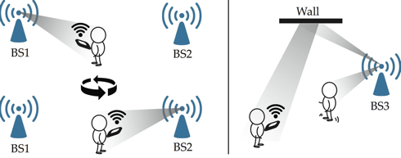
Need hyper-efficient channel tracking
To maintain a robust link despite mobility
Overcome blockage
Interference management to utilize spatial reuse
Handover
…
Picocell
Picocell
Notes:
To overcome higher path loss, we need larger more directional arrays. Small wavelength means large arrays are easy to make even on a small base.
For mobile communication, beamforming in direction of link needs frequent discovery (tracking) of direction.
Channel tracking provide an important step toward practical mmwave network

Slide 7

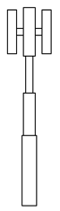
How rapidly must we track?
How long before direction information expires?
Speed of mobile user
Width of beam
V
W=rθ
θ
Pedestrian V=5 m/s | Update every 40ms
Vehicle V=20 m/s | Update every 10ms
< 1ms (desired)
10ms
Tracking phase
Communication phase
Tracking phase
Notes:
The frequency of updating direction information depends on speed of mobile user and beam width (i.e. array size)
How frequent? 12x3/180=.2 radx5=1m
Some simple math:
Speed is 5-20m/s, beam illumination area is 1m for 12 degree beam at (minimum) distance of 5m
So it takes traveler 25-100 ms to lose signal (mid-beam to edge)
Update once every 25-100 ms (10-40 times per second)

Slide 8
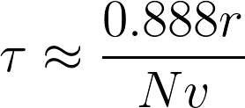
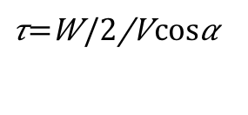
Basic calculations
V
W=rθ
θ
$$τ=\frac{W/2}{V\cos{α}}$$
Tracking overhead?
angle between speed
and beam cross section
Approximation under worst-case settings for N x N array
Need to update more frequently for larger arrays
Example: urban picocellular base station tracking a vehicle

Slide 9
Example designs
4x4
Update every 40ms
16x16
Update every 10ms
32x32
Update every 5ms

Slide 10
Outline
Motivation and Background
There is a huge capacity at mmwave band
Path tracking is the key bottleneck
Shortcomings of conventional approaches
Compressive estimation a promising alternative
Noncoherent compressive estimation
Works with off-the-shelf hardware
Evaluation on 60 GHz testbed and simulations

Slide 11



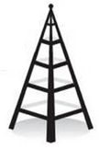
Conventional direction finding techniques
Exhaustive scanning

Slide 12

Conventional direction finding techniques
Exhaustive scanning
Feedback RSS
Does not scale well with # of antennas ( N )

Slide 13

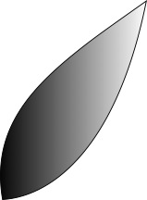
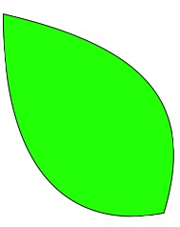

Conventional direction finding techniques
Hierarchical scanning:
✔
Scales well with # of antenna ( log(N) )
Too much feedback overhead and delay
Does not scale well with # of users
Compromise on range and reliability
Feedback RSS

Slide 14
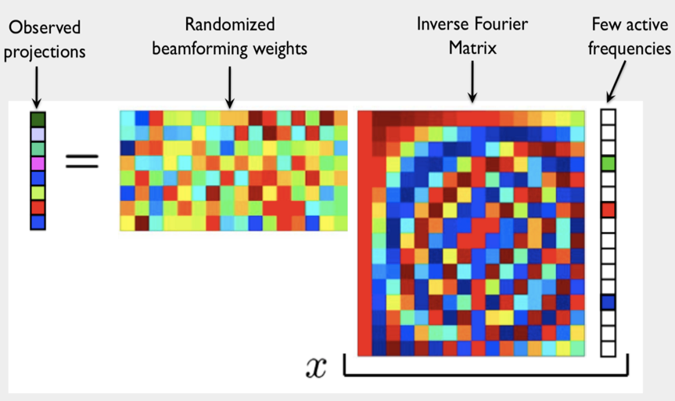
Compressive sensing: basic concept
Kx1
K<<N
Our framework: borrow the idea of pseudorandom projections for channel estimation
Nx1
Notes:
Refer
Develop our own framework but borrow some basic ideas from ..
Classical compressive sensing aims to reconstruct signals
which are sparse in a discrete basis, based on a small number
of projections.
these ideas are extended to compressive estimation,
in which a small number of projections are used to estimate
continuous-valued parameters.

Slide 15



Mmwave channel model
High dimension
(N)
Sparse
(a few paths)
Notes:
Refer
Develop our own framework but borrow some basic ideas from ..
Classical compressive sensing aims to reconstruct signals
which are sparse in a discrete basis, based on a small number
of projections.
these ideas are extended to compressive estimation,
in which a small number of projections are used to estimate
continuous-valued parameters.

Slide 16
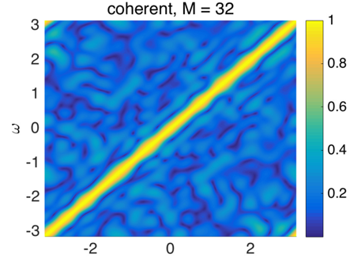
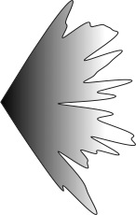

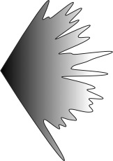

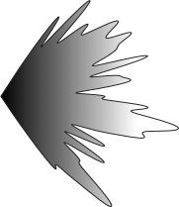
Compressive estimation
Feedback Y
32 beacons
✔ Overhead (# of beacons) scales as Log(N)
✔ scalable with # of users
✔ Each user sends only one feedback packet
✔ Support coarse phase control (e.g. 2bit)
Template matching
True freq.
Feedback Y
Z. Marzi, D. Ramasamy and U. Madhow, "Compressive Channel Estimation and Tracking for Large Arrays in
mm-Wave Picocells,” IEEE Journal of Selected Topics in Signal Processing

Slide 17
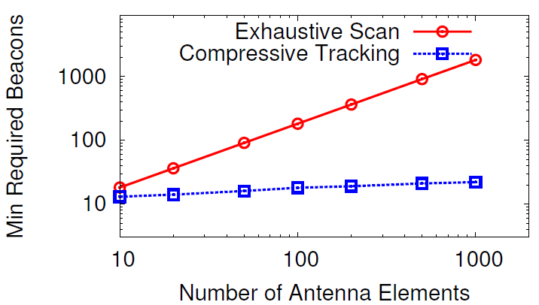
#beacons scale logarithmically with #elements
1000 element array can be trained with only 24 beacons
5 μs per beacon
training time < 120 μs
overhead < 1.2 % (once every 10 ms for fast car)
Notes:
Target accuracy: beamforming loss below 3 dB with 99% probability

Slide 18
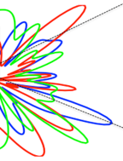
But todays’s transceivers can only do Noncoherent measurements
Frequency offset between local oscillators at TX and RX
Random phase offset in measurements
Phase of measurements cannot be used!
RSS-only measurements
δ
2δ
3δ
Feedback |Y|

Slide 19
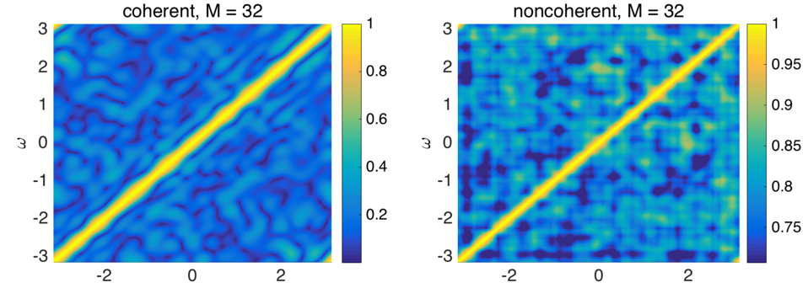
Noncoherent compressive sensing
--Match (normalized) RSS measurements against expected RSS measurements across “spatial frequencies”
--Noisier for noncoherent, but it still works
32 beacons
32 beacons
32 beacons
Template matching
Template matching
True spatial freq.
True spatial freq.

Slide 20
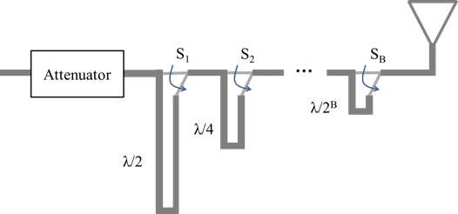
Hardware scalability: coarse phase control
Large arrays, limited number of RF chains
Simple RF phase control, for example via delay lines
➔ severe quantization of beamforming phases
Scanning requires fine-grained control
Compressive approaches works fine with severe phase quantization

Slide 21
ExperimentS

Slide 22
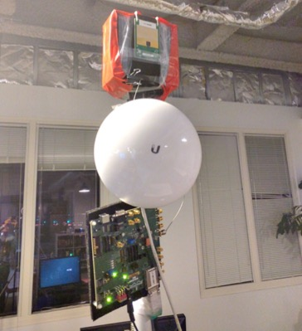
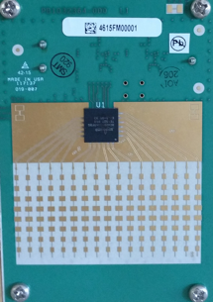
Hardware: 60GHz testbed
A pair of
16x8 antenna array
16x8 antenna
5GHz WiFi
Baseband Board
Thanks: Facebook Terragraph team

Slide 23
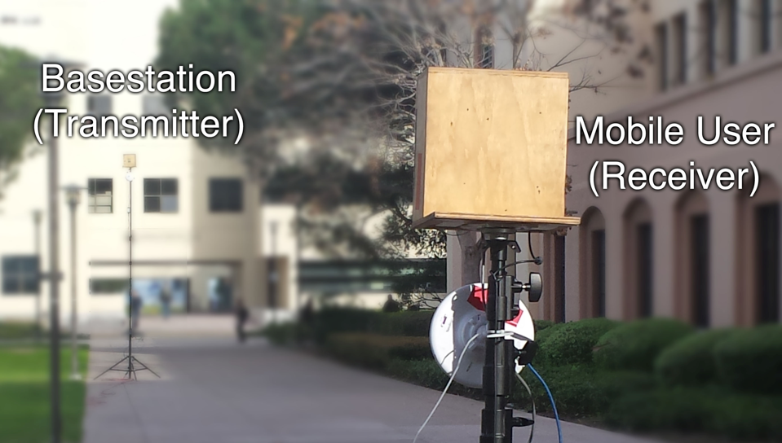

Slide 24
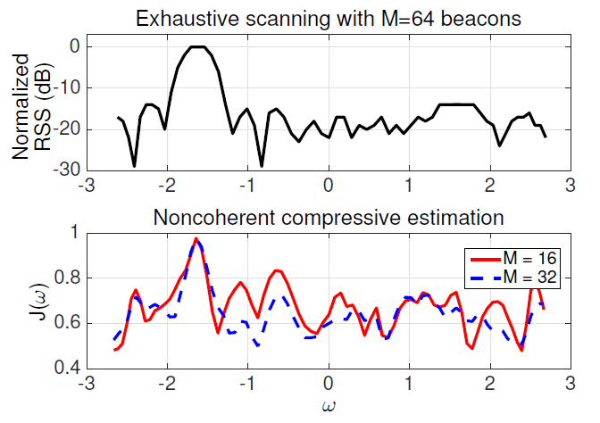
Noncoherent cost function follows the same pattern as exhaustive scan

Slide 25
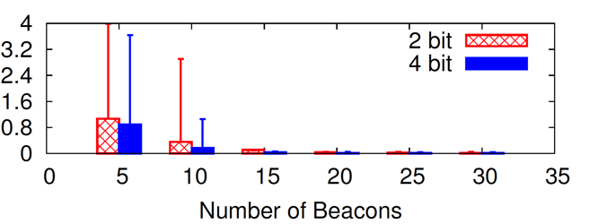
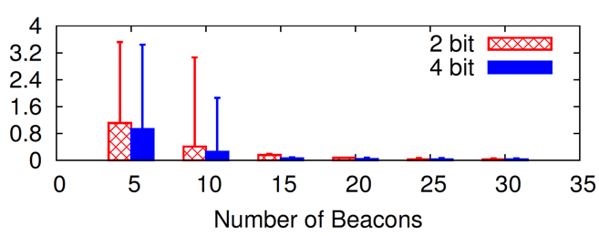
Dominant path identified effectively
Single path
Two path (one dominant path 8 dB stronger)
Spatial freq. error
Spatial freq. error
Notes:
Mean and 95 percentile

Slide 26
Sims show effective scaling with array size
Notes:
Target accuracy: beamforming loss below 3 dB with 99% probability

Slide 27
Compressive tracking take-aways
Compressive channel tracking eliminates a key bottleneck to Cellular 1000X (and other mm-wave systems)
Low overhead
Scalable with # of users and # of antenna elements
Compatible with simplified hardware (heavily quantized phases)
Noncoherent compressive estimation works with today’s hardware
Effective solution demonstrated when there is a single dominant path
Recent result: noncoherent algorithms for multipath channels

Slide 28
Opens up new system design challenges
Assuming each base station maintains path inventory for nearby mobile users
How do the base stations coordinate to provide robust connectivity?
How do the base stations coordinate to provide high throughput and manage interference?
How do we manage the transport layer?
What are the implications for backhaul requirements?

Slide 29
Appendix
Details of compressive scheme

Slide 30
Estimation problem
Channel is a sum of a few sinusoids
Estimate gains and spatial frequencies from compressive measurements

Slide 31
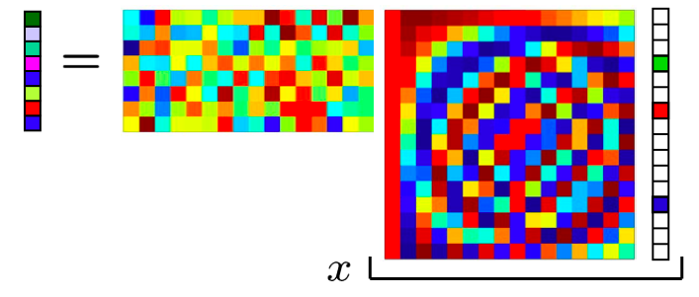
Can we use standard compressed sensing?
Observed
projections
Randomized beamforming weights
Gains of active frequencies
Fourier Basis
Picture from plenary
by Rich Baraniuk, ISIT 2009
Picture from plenary
by Prof. R. Baraniuk, ITSoc ‘09
Notes:
Suppose that nodes, environment everything is stationary

Slide 32
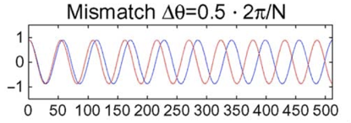
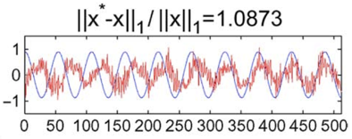
Basis mismatch is the problem
With standard CS, off-grid frequencies can have large estimation errors
Frequencies come from a continuum, not a grid
Sensitivity to Basis Mismatch in Compressed Sensing,
Y. Chi, L. Scharf, A. Pezeshki, R. Calderbank
Need compressive estimation in a continuum

Slide 33
Algorithm
Acquisition
No knowledge of spatial frequencies whatsoever
Tracking
Leverage frequency estimate from previous round
Refine based on new measurements

Slide 34
Acquisition: Coarse Estimate
Notes:
At the beginning, don’t know the number of frequencies or their locations
Maximize the inner product between the observations and the sinusoids over a coarse grid

Slide 35
Acquisition: Coarse Estimate
Notes:
At the beginning, don’t know the number of frequencies or their locations

Slide 36
Iterative refinements
Given
Coarsely estimate (K+1)th freq
Gains:
Freqs:
Project out contributions from these frequencies
Fix gains:
Refine freqs:
Fix freqs:
Estimate g’s:
Stop when residual energy can be explained by noise: CFAR criterion
Notes:
Begin as before: pretend that there is only one frequency. Coarse estimate over 2N grid. Refine g and omega iteratively.

Slide 37
Simulation Setup
Array on
lamp post

Slide 38
Within a dB of ideal beamforming

Slide 39
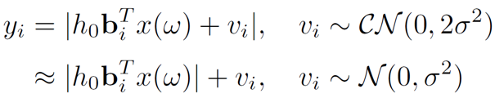
The need for noncoherent tracking
Phase synchronization not maintained between packets
Relative phase of measurements is corrupted
Coherent compressive estimation does not work
Effective measurement model (high SNR approximation)

Slide 40
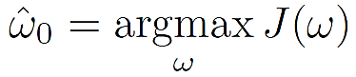
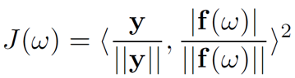
Noncoherent compressive tracking (single path)
Noncoherent template matching gives ML estimate under high SNR approximation

Slide 41
Noncoherent compressive tracking (single path)
32 beacons
32 beacons
32 beacons
Template matching
Template matching
True spatial freq.
True spatial freq.

Slide 42
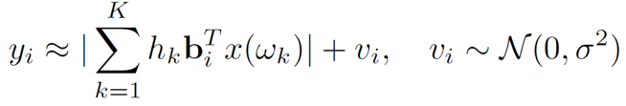
What about multiple strong paths?
How do we sort out interference across paths?

Slide 43
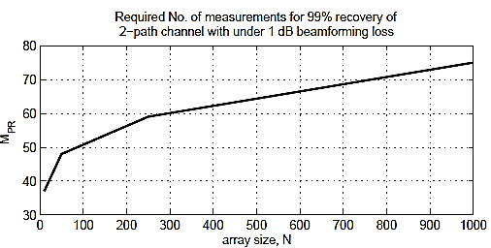
Recent result: Noncoherent can be made almost as efficient as coherent
Details omitted until publication
Experimental results not yet obtained

Slide 44

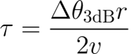
Time scale of tracking mobile user

Slide 45
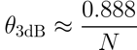
Time scale of tracking mobile user
3-dB beamwidth of N element array:

Slide 46
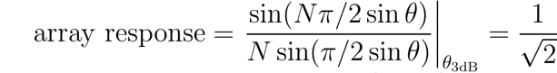
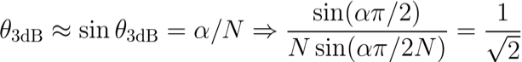

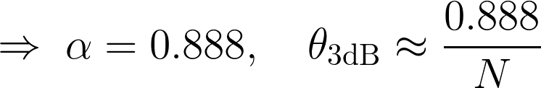
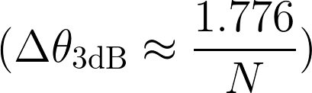
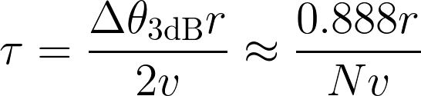
Time scale of tracking mobile user
3-dB beamwidth of N element array:

